Slide 1
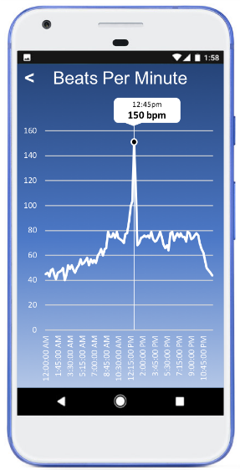
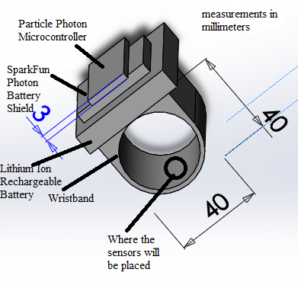
NuCare Band: Cardiac Bio-System Monitoring
Team D: Li Teng Cheok | Alfonso Diaz | Younghoon Jee | Carson Lai | Qassam Yomok | Date: August 2nd ,2018
CardioTech Labs
System Overview
Hardware Design
Photon: Main controller board that will connect all the sensors and peripherals
Pulse Sensor: used to measure the users heart rate.
MAX30102: used to measure the blood oxygen level.
Conclusion
NuCare Band enables doctors and users to monitor their vital signs, allowing for better diagnosis, and care for newly released patients.
Contact Info:
Alfonso Diaz
Email: adiazalo@sfu.ca
Sensors
Photon Microcontroller
Windows Command Line
Particle Server
FireBase
Application
Webhooks
ThinkSpeak Platform
Introduction
Goal: Allow user’s vitals to be monitored by doctors remotely
Heath Conference in 2017, shows doctors are concerned over the health of newly released patients. [1]
The 28-day readmission rate for older people has doubled from 103,000 in 2001–2 to 201,000 in 2010–11 [2]
References
Solution
Wearable wrist band with sensors to monitor heart rate and blood oxygen level
Application to display live data of heart rate and blood oxygen level.
Alerting users and doctors when abnormal activity occurs.
Rechargeable and Reusable device.
Software Design
Photon Particle Cloud: remotely update and control the main controller board.
ThingSpeak: allows data to graphed in real time
[1] J. Comstock, "MobiHealthNews," HIMSS Media, 3 November 2017. [Online]. Available: http://www.mobihealthnews.com/content/five-barriers-wider-clinical-wearable-adoption. [Accessed 29 May 2018].
[2]Express.co.uk, "Readmission rates raise care fears," [Online]. Available: https://www.express.co.uk/news/uk/376929/Readmission-rates-raise-care-fears. [Accessed 29 July 2018].
Coming Soon
Android application displays current heart rate and blood oxygen level
Blood pressure apparatus, with quick connect option to the main system
Public release of NuCare Band.
Target Audience
Newly released hospital patients
Medical Professionals

Slide 2
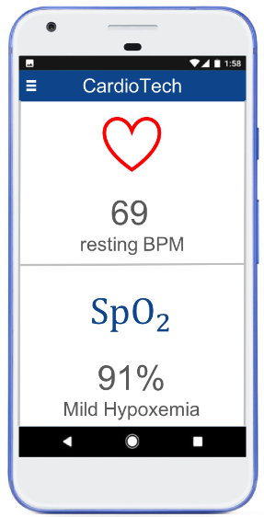
NuCare Band: Cardiac Bio-System Monitoring
Team D: Li Teng Cheok | Alfonso Diaz | Younghoon Jee | Carson Lai | Qassam Yomok | Date: August 2nd ,2018
CardioTech Labs
System Overview
Hardware Design
Photon: Main controller board that will connect all the sensors and peripherals
Pulse Sensor: used to measure the users heart rate.
MAX30102: used to measure the blood oxygen level.
Conclusion
NuCare Band enables doctors and users to monitor their vital signs, allowing for better diagnosis, and care for newly released patients.
Contact Info:
Alfonso Diaz
Email: adiazalo@sfu.ca
Sensors
Photon Microcontroller
Windows Command Line
Particle Server
FireBase
Application
Webhooks
ThinkSpeak Platform
Introduction
Goal: Allow user’s vitals to be monitored by doctors remotely
Heath Conference in 2017, shows doctors are concerned over the health of newly released patients. [1]
The 28-day readmission rate for older people has doubled from 103,000 in 2001–2 to 201,000 in 2010–11 [2]
References
Solution
Wearable wrist band with sensors to monitor heart rate and blood oxygen level
Application to display live data of heart rate and blood oxygen level.
Alerting users and doctors when abnormal activity occurs.
Rechargeable and Reusable device.
Software Design
Photon Particle Cloud: remotely update and control the main controller board.
ThingSpeak: allows data to graphed in real time
[1] J. Comstock, "MobiHealthNews," HIMSS Media, 3 November 2017. [Online]. Available: http://www.mobihealthnews.com/content/five-barriers-wider-clinical-wearable-adoption. [Accessed 29 May 2018].
[2]Express.co.uk, "Readmission rates raise care fears," [Online]. Available: https://www.express.co.uk/news/uk/376929/Readmission-rates-raise-care-fears. [Accessed 29 July 2018].
Coming Soon
Android application displays current heart rate and blood oxygen level
Blood pressure apparatus, with quick connect option to the main system
Public release of NuCare Band.
Target Audience
Newly released hospital patients
Medical Professionals

Slide 3
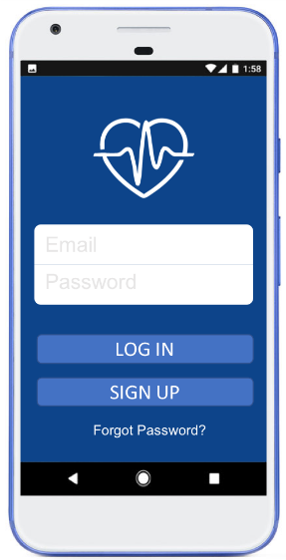
NuCare Band: Cardiac Bio-System Monitoring
Team D: Li Teng Cheok | Alfonso Diaz | Younghoon Jee | Carson Lai | Qassam Yomok | Date: August 2nd ,2018
CardioTech Labs
System Overview
Hardware Design
Photon: Main controller board that will connect all the sensors and peripherals
Pulse Sensor: used to measure the users heart rate.
MAX30102: used to measure the blood oxygen level.
Conclusion
NuCare Band enables doctors and users to monitor their vital signs, allowing for better diagnosis, and care for newly released patients.
Contact Info:
Alfonso Diaz
Email: adiazalo@sfu.ca
Sensors
Photon Microcontroller
Windows Command Line
Particle Server
FireBase
Application
Webhooks
ThinkSpeak Platform
Introduction
Goal: Allow user’s vitals to be monitored by doctors remotely
Heath Conference in 2017, shows doctors are concerned over the health of newly released patients. [1]
The 28-day readmission rate for older people has doubled from 103,000 in 2001–2 to 201,000 in 2010–11 [2]
References
Solution
Wearable wrist band with sensors to monitor heart rate and blood oxygen level
Application to display live data of heart rate and blood oxygen level.
Alerting users and doctors when abnormal activity occurs.
Rechargeable and Reusable device.
Software Design
Photon Particle Cloud: remotely update and control the main controller board.
ThingSpeak: allows data to graphed in real time
[1] J. Comstock, "MobiHealthNews," HIMSS Media, 3 November 2017. [Online]. Available: http://www.mobihealthnews.com/content/five-barriers-wider-clinical-wearable-adoption. [Accessed 29 May 2018].
[2]Express.co.uk, "Readmission rates raise care fears," [Online]. Available: https://www.express.co.uk/news/uk/376929/Readmission-rates-raise-care-fears. [Accessed 29 July 2018].
Coming Soon
Android application displays current heart rate and blood oxygen level
Blood pressure apparatus, with quick connect option to the main system
Public release of NuCare Band.
Target Audience
Newly released hospital patients
Medical Professionals

